Slide 1
Home Learning Year 3
W/C 8st June 2020
Respect, Resilience, Pride, Courage, Team Work

Slide 2
Team HPS
The Basics
Your child will receive a weekly PowerPoint on Monday Morning by 9am that contains their learning for each day that week. This will include:
Daily Maths and English task
Weekly project
Weekly spellings and timetables to learn
There are some added optional extras too. We have included a weekly picture news section with some suggested activities and discussions.
If you still want some additional resources, your year group also has a suggested daily timetable with links to other resources, activities and games, which can also be found on the school website.
Each week you will have access to our very own home learning ‘Help Desk’ where you can talk to one of the team about anything you are finding tricky in your learning that week.

Slide 3
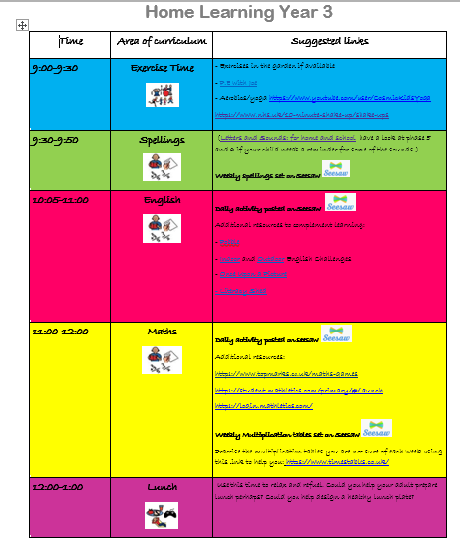
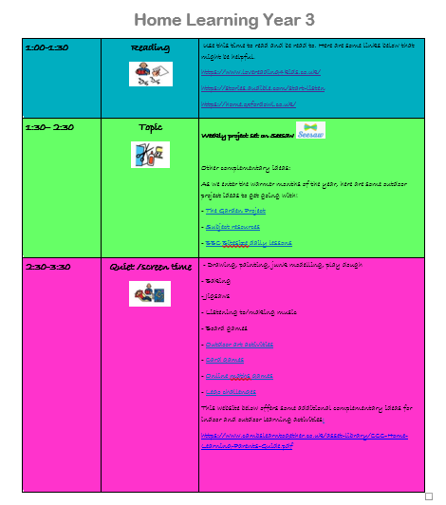
Suggested timetable (available on the website to download)

Slide 4
8th June
Maths Learning this week…

Slide 5
Monday- LC: To find equivalent fractions. Tuesday: LC: To find equivalent fractions (2) Wednesday LC: To find equivalent fractions (3) Thursday: LC: To compare fractions Friday: LC: To consolidate my learning (Maths challenge)
Maths W/C 8.6.20
For each day this week…
Watch the video for each of the 5 lessons this week by coping this website into your internet browser. https://whiterosemaths.com/homelearning/year-3/ . This week you are following the lessons – Summer Term- Week 7 (W/C 8th June)
Complete the follow up activities each day that can be found using this link: https://www.bbc.co.uk/bitesize/tags/zmyxxyc/year-3-and-p4-lessons There will a range of activities including worksheets, games and quiz style activities. Alternatively, to the right of the tutorial videos are direct links called ‘bitesize’. This will also take you to the correct website. Select your child’s year group and you will find the activities are linked directly to the video you will have just watched.

Slide 6
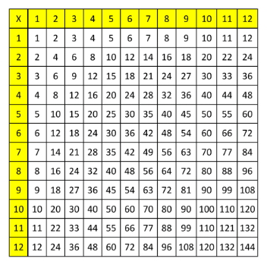
Multiplication table of the week
This week we would like you to focus on your 4x tables.
Perhaps you could upload yourself reciting your multiplication facts? Could you ask an adult to test you?

Slide 7
8th June
English Learning this week

Slide 8
Monday 8th June English Task
LC: To ask and answer questions about the book I am reading
This week you are going to be retelling the story of Little Red Riding Hood. Watch the link below and then answer the questions on the video in full sentences.
http://www.viewpure.com/RT-EwqgHqCk?start=0&end=0
1. Who is the main character?
2. How did she get her name?
3. Why did Little Red Riding Hood take her grandmother cookies?
4. What did picking the flowers result in?
5. How did Little Red Riding hood feel when she was lost? How do you know?
6. Who was the hunter looking for in the forest? What does this tell you about the character he was looking for?
8. What was different about the Grandma? How do you know Little Red Riding Hood was suspicious?
9. How did the hunter rescue the Grandmother?
10. What was the wolf’s punishment? Do you think this was enough?

Slide 9
Tuesday 9th June
LC: To sequence events
The wolf arrived at Grandmother’s house and gobbled her up
Little Red Riding hood walks through the forest
She noticed her Grandmother looked different.
Little Red Riding Hood’s mother asks her to visit her sick Grandmother
Little Red Riding Hood arrived at Grandmother’s house
She picks some flowers and wandered off the track. The Big Bad Wolf spotted her and she told him where she was going.
The hunter rescued Little Red Riding Hood and her Grandmother
Little Red Riding Hood was lost and met the hunter.
After watching the video again, your task is the sequence the events in order. Add additional information into each section to describe the character’s thoughts, feelings and emotions.
http://www.viewpure.com/RT-EwqgHqCk?start=0&end=0

Slide 10
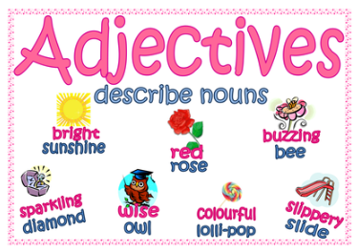
^{Wednesday 8th} June
LC: To use noun phrases
Last week you came up with adjectives to describe a forest. This time we would like you to create 2A sentences to describe parts of the characters in the story. A 2A sentence is where you use 2 adjectives before a noun to describe it.
Example: Enormous, sharp teeth
Think about:
What are the wolf’s ears like?
What is Little Red Riding Hood’s cape like?
What is the Grandma’s hair like?
Challenge question:
Are you using the best adjectives that you can? Are they appropriate?

Slide 11
Thursday 9th June
S
LC: To plan my ideas
Start
Task: Today you need to plan your retelling of the story of Little Red Riding Hood. Create a story S of the key events, adding any extra information that will help you write your story.
Middle
End
Challenge: Add time conjunctions to help you connect the different parts of your story e.g. first, after that, next, finally

Slide 12
Friday 5th June
LC: To write a setting description.
Task:
Today you are going to use your plan to rewrite the story of Little Red Riding Hood
SC:
Adjectives (describing words)
2A sentences
Capital letters and full stops
Time conjuctions (first, next)
Paragraphs for change in time and place
Third person (She could see…)

Slide 13
Spellings list
Perhaps a parent or Carer could test you at the end of the week? You could post a photo on Seesaw to let us know how you get on!
Arrive
accident
Actual
Appear
Breath
Build
Busy
Circle
Decide
Earth

Slide 14
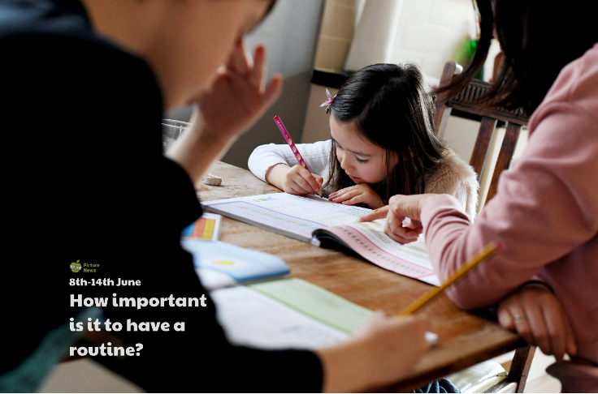
News

Slide 15
News

